Slide 1
Crop-Aware Panoptic Segmentation
Mehdi Naouar, Ben Bausch, Yannick Vogt

Slide 2
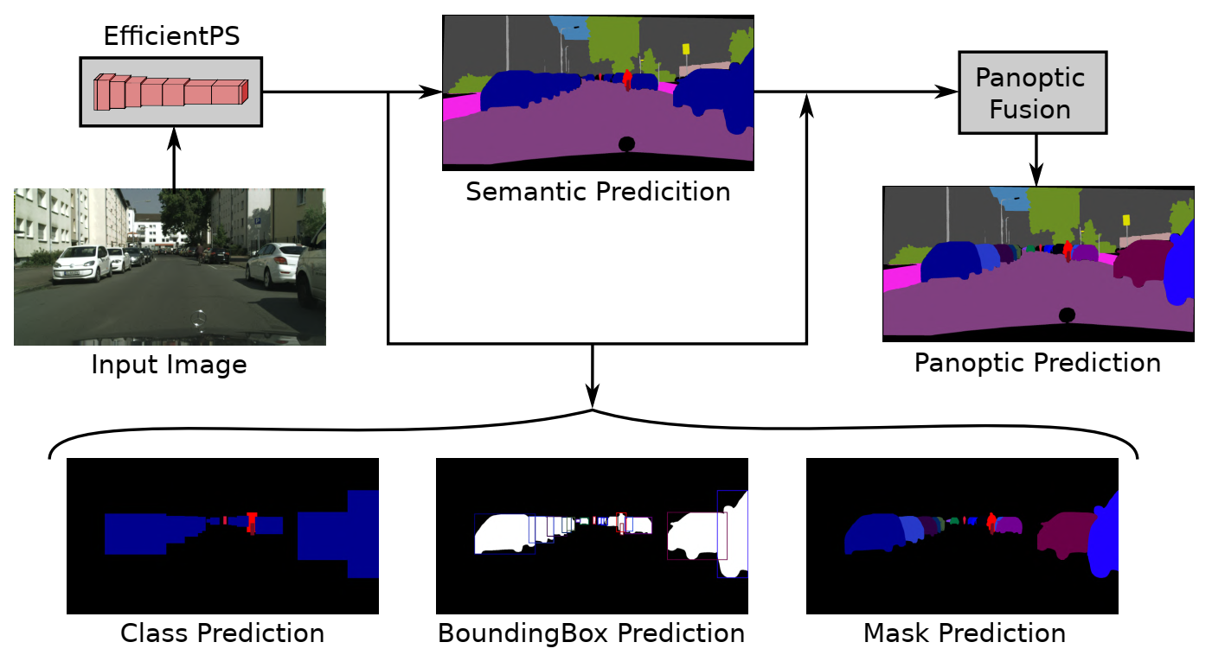
Panoptic Segmentation
[1]
Notes:
What is Panoptic Segmentation?
Whats the goal?
Rohits Paper

Slide 3
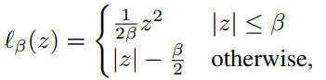
Bounding Box Prediction
Region Proposal Network proposes anchor boxes
Fully Connect Layer regresses transformations applied to the anchor to fit the ground truth Bounding Box
Smooth-L1 Loss

Slide 4
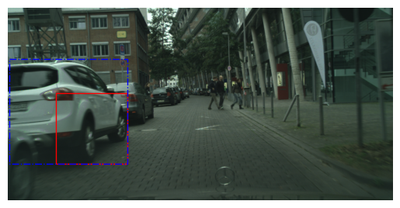
Bounding Box Example
Ground Truth, Anchor Box

Slide 5
Motivation
Full-size images consume too much memory
Downsampled images can’t represent fine structures
Idea: Train on crops

Slide 6
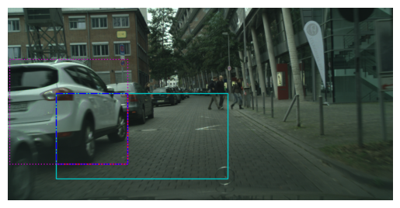
Crop Based Training
Allows training of larger networks or higher batch size
Fine structures can be preserved
Large objects might be truncated
Cropped Ground Truth, Original Ground Truth,
Crop Area

Slide 7
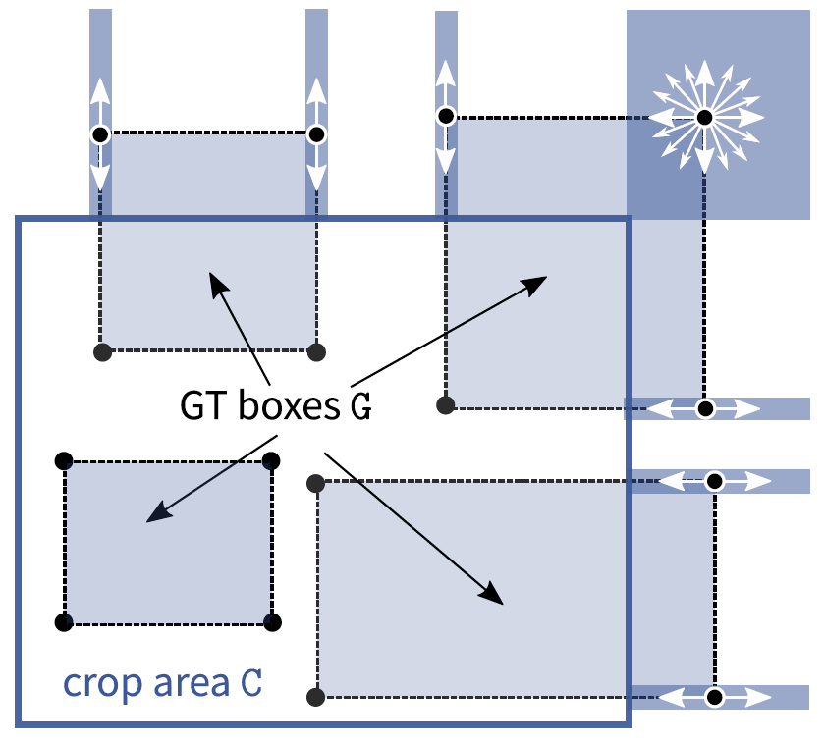
Crop-Aware Bounding Boxes (CABB)
Network is allowed to “hallucinate”
Can improve performance on objects which were cropped in training
[2]
Notes:
Explain cases
only outside can be modified

Slide 8
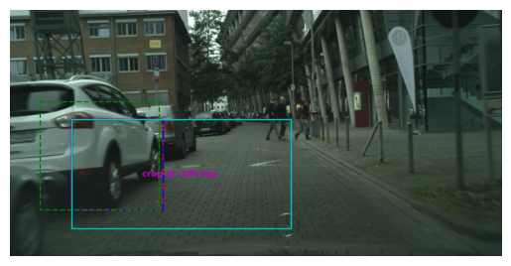
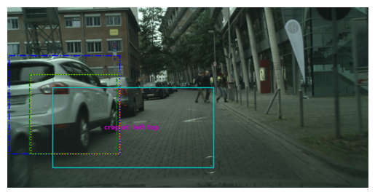
Visualization of CABB
Error without CABB
Error with CABB
Ground Truth, Prediction, Crop Area, Anchor Box, CABB Target
Notes:
With CABB is an adapted version is a greater equal in SOLVE O1
Left ground truth is cropped
We save the original gt
Right side we optimize a new target that minimizes loss based on cases
Explain colors

Slide 9
Dataset
Cityscapes Dataset
2975 training samples
500 validation samples
1525 test samples without ground truth
2048 x 1024 pixels

Slide 10
Training Setting
1024 x 512 image size, 512 x 256 crop size
100 epochs of training with 2975 training images
8 image per batch on a single GPU
~37.200 iterations

Slide 11
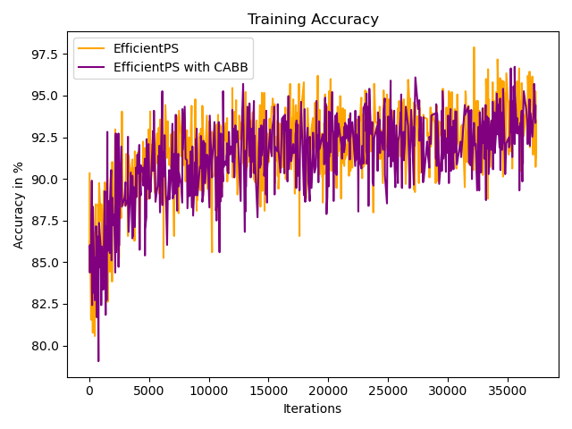
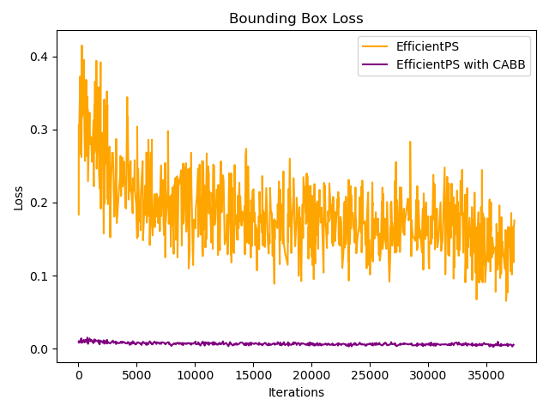
Training Results
39.5h with CABB vs 20.75h without CABB

Slide 12
Validation Results
Validate models at epoch 100 on 500 full-sized images
Without CABB | PQ | SQ | RQ | N
All | 47.6 | 75.5 | 60.9 | 19
Things | 42.0 | 75.1 | 55.8 | 8
Stuff | 51.7 | 75.8 | 64.5 | 11
CABB | PQ | SQ | RQ | N
All | 35.0 | 71.5 | 46.2 | 19
Things | 32.0 | 72.2 | 44.2 | 8
Stuff | 37.1 | 71.0 | 47.7 | 11

Slide 13
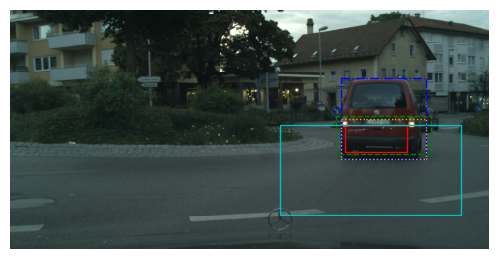
CABB prediction after Training
Ground Truth, Prediction, Crop Area, Anchor Box, CABB Target

Slide 14
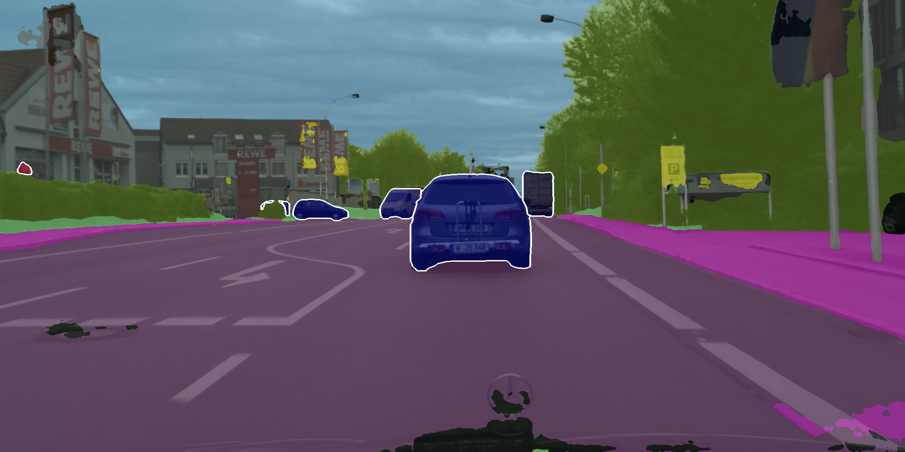
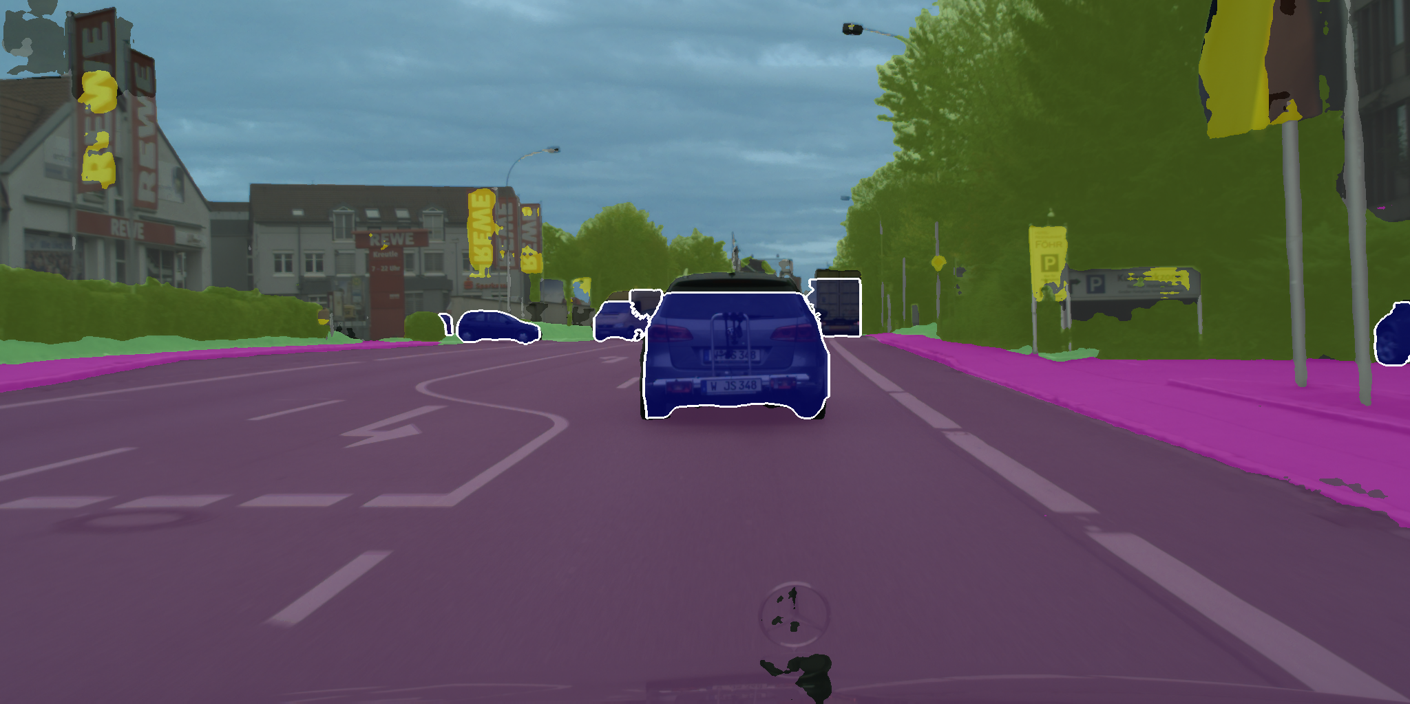
Panoptic Segementation
EfficientPS
EfficientPS with CABB

Slide 15
Conclusion
Massive decrease in performance
Potential issues:
Mistakes in implementation
Loss too low in comparison to other losses
Network crops objects based on Bounding Boxes

Slide 16
References
[1] Rohit Mohan, Abhinav Valada. EfficientPS: Efficient Panoptic Segmentation. arXiv:2004.02307v3, 2021
[2] Lorenzo Porzi, Samuel Rota Bulò, Peter Kontschieder. Improving Panoptic Segmentation at All Scales. arXiv:2012.07717v2, 2021

Slide 17
Thank you for your attention!

Slide 18
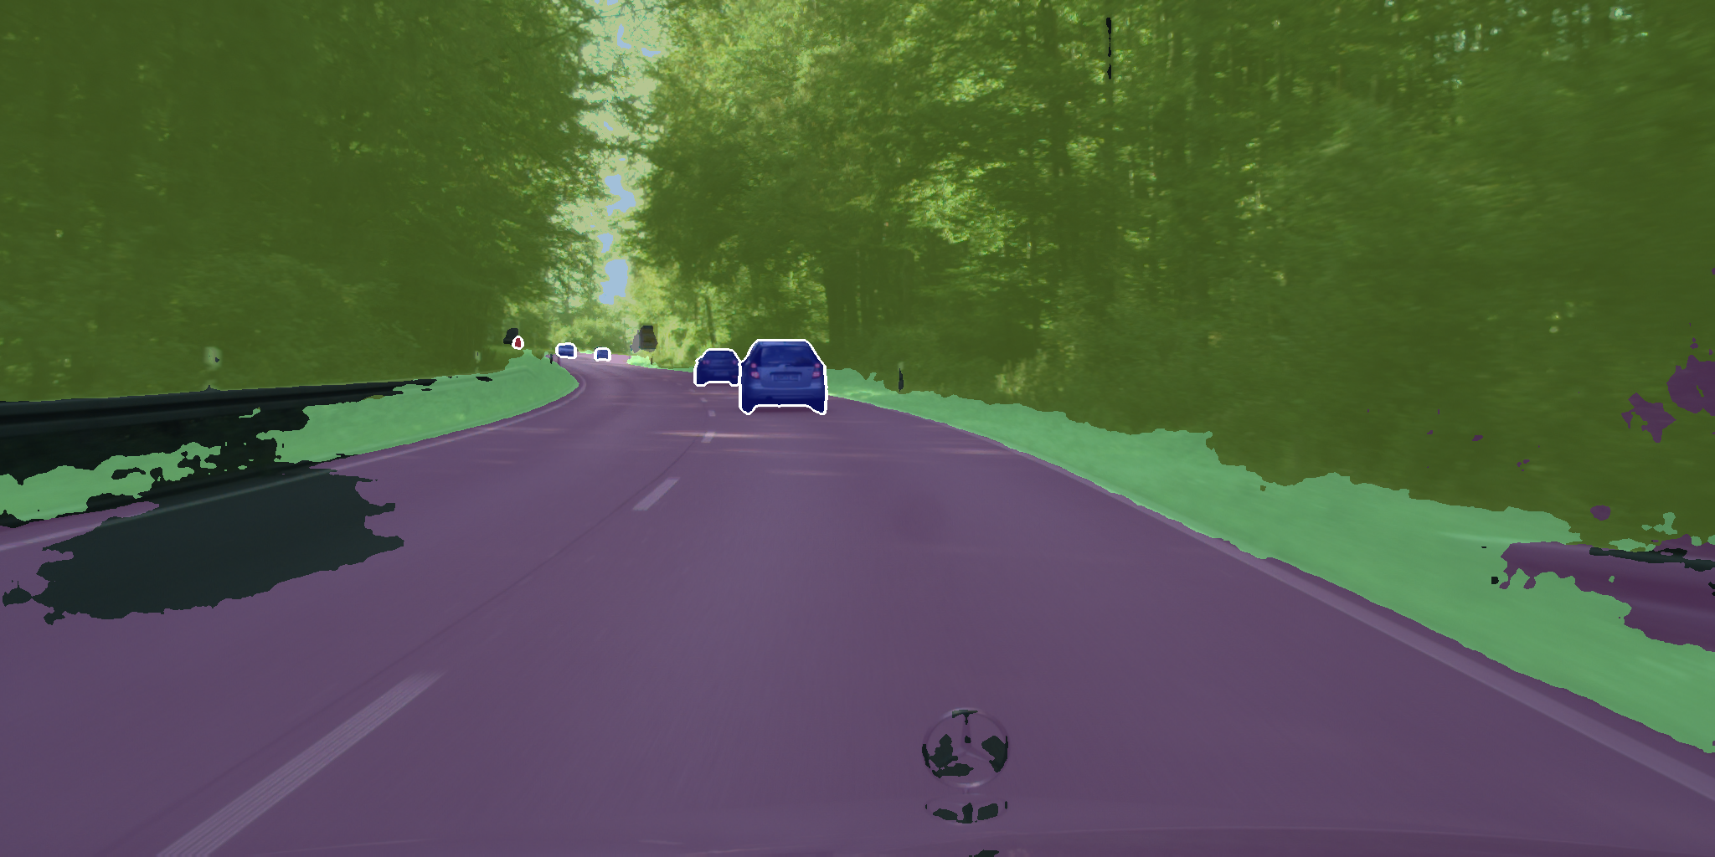
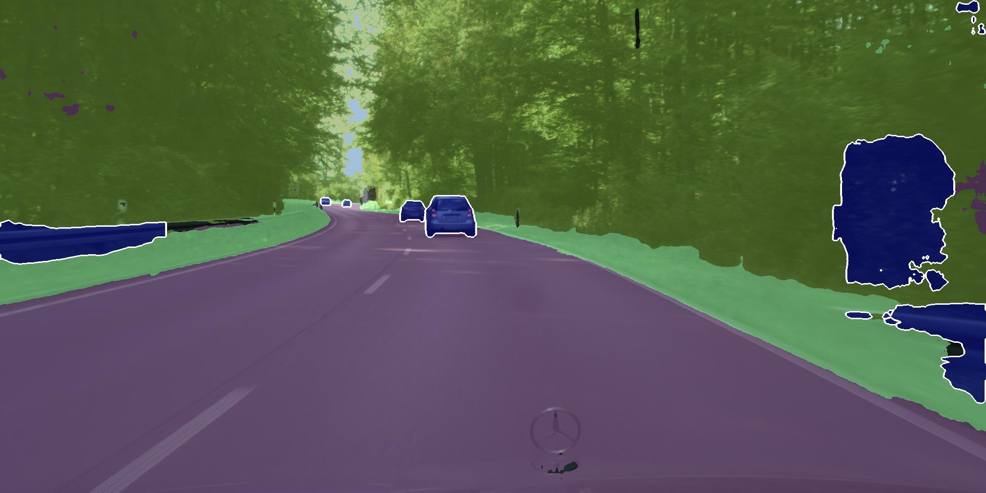
EfficientPS
EfficientPS with CABB

Slide 19
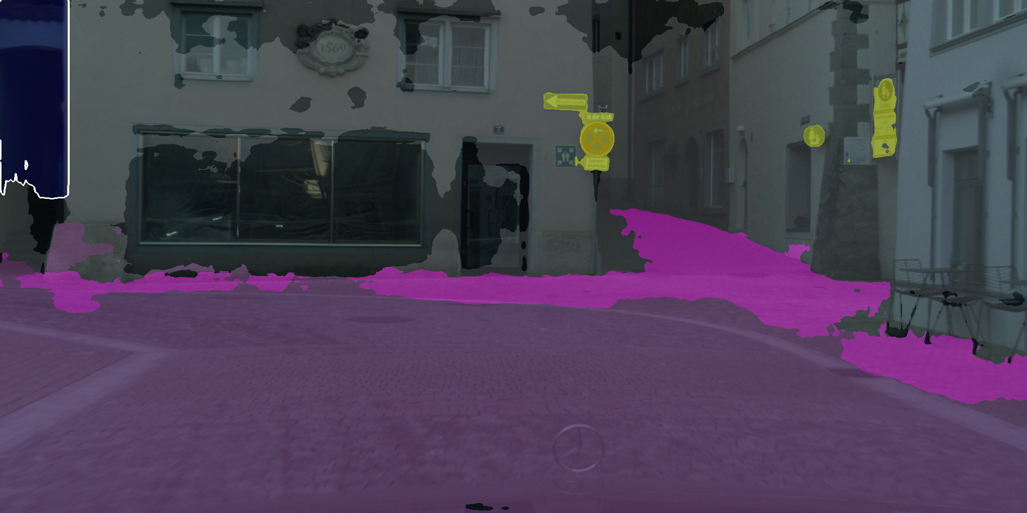
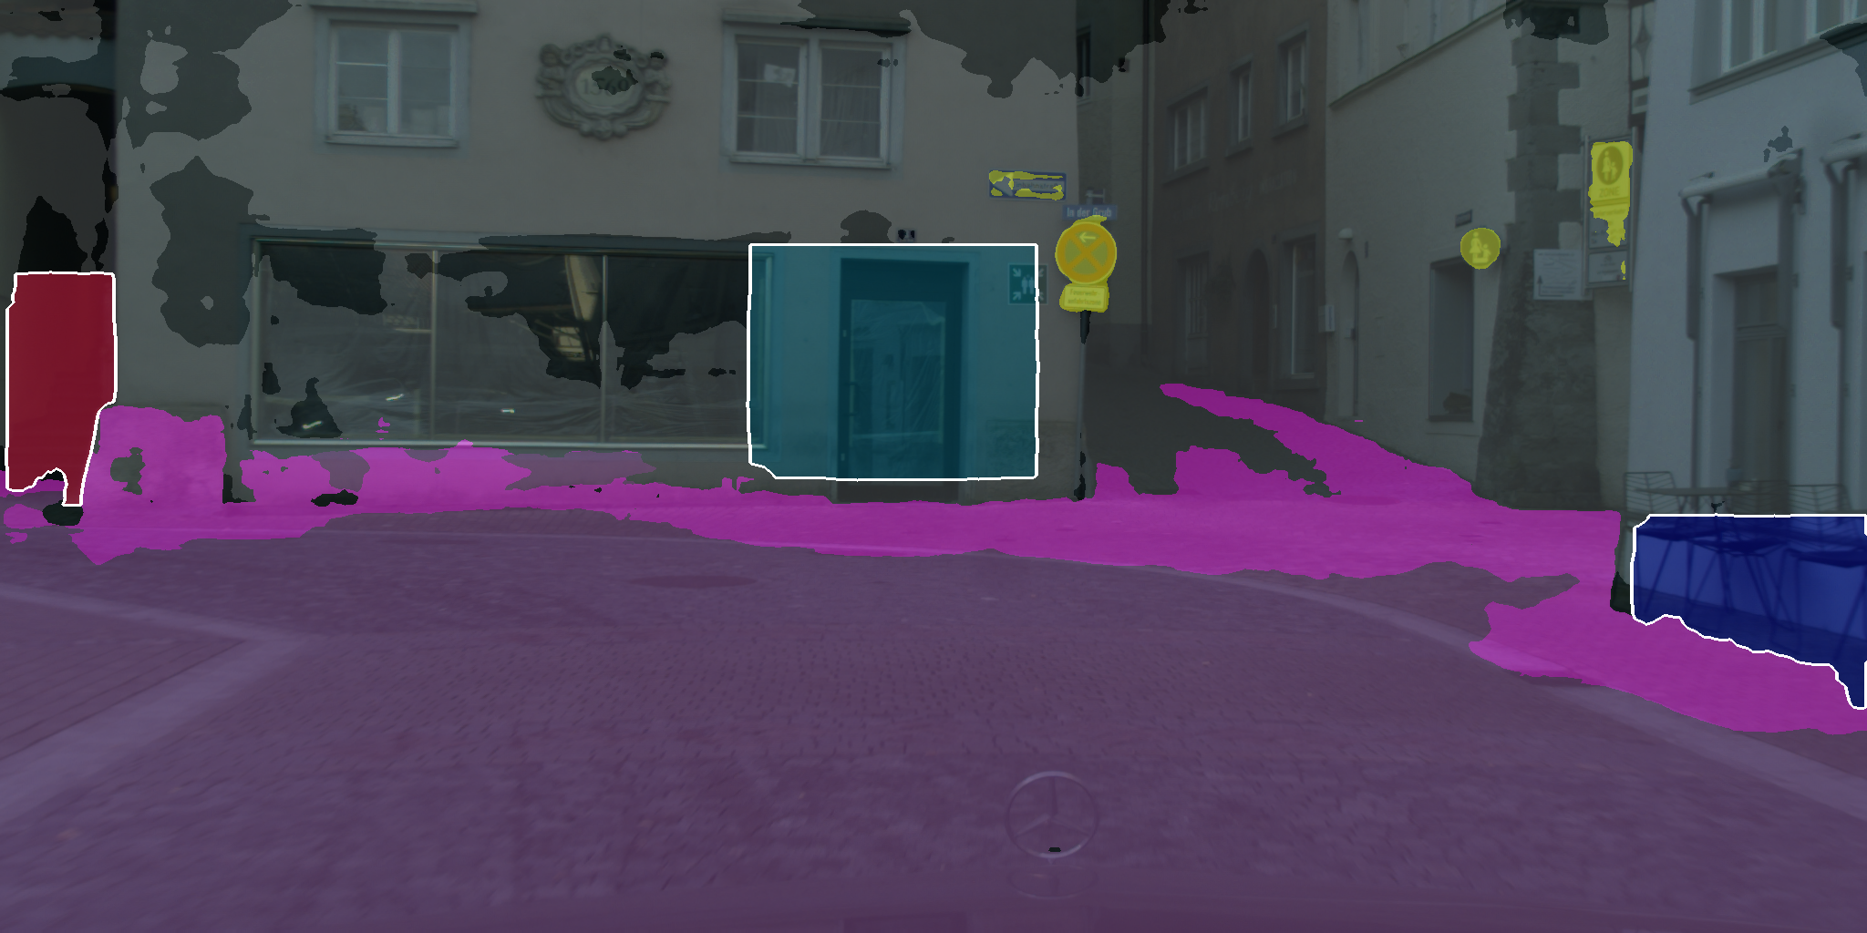
EfficientPS
EfficientPS with CABB

